Slide 1
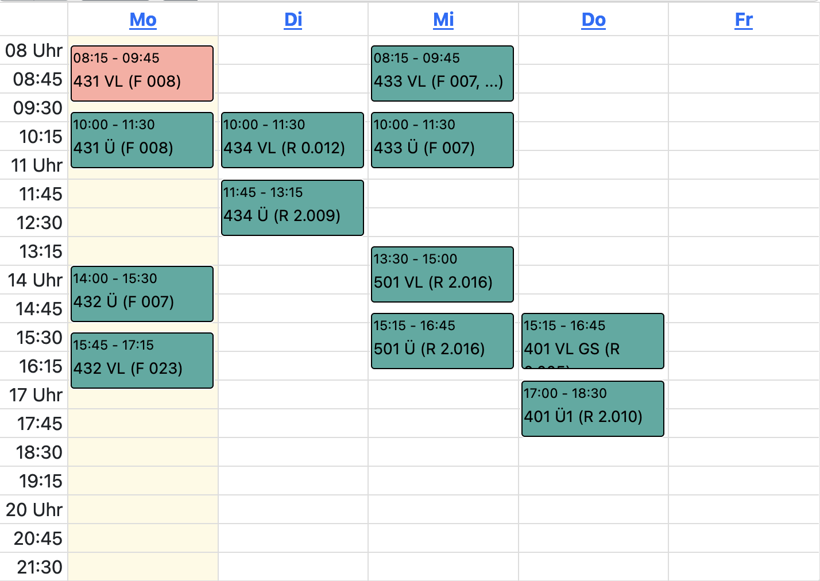
You know this issue?

Slide 2
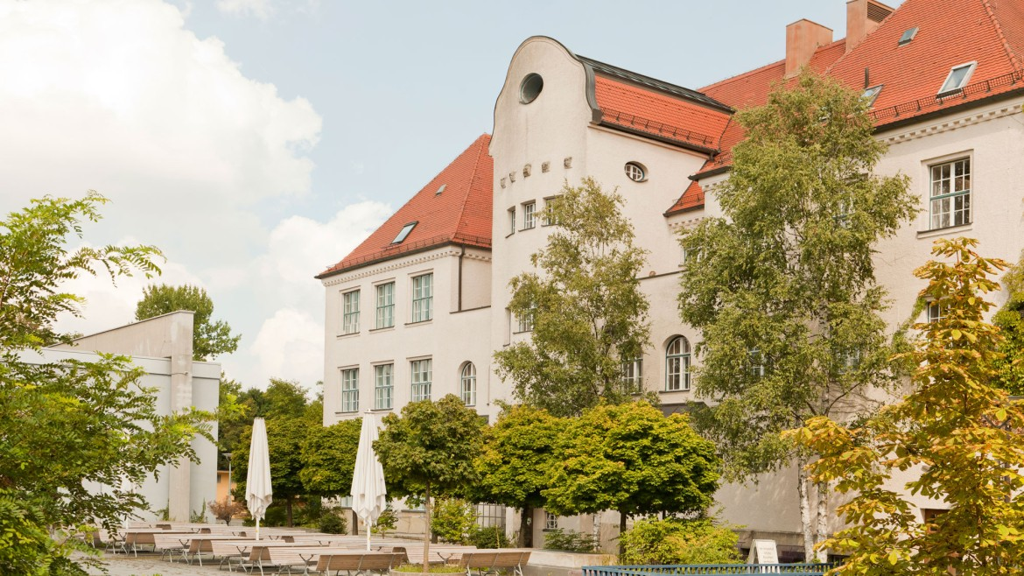
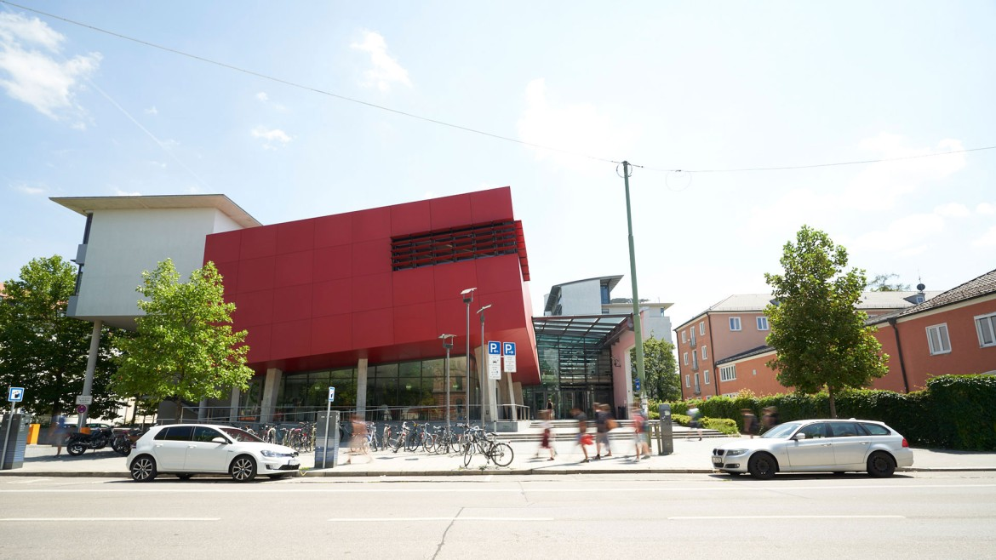
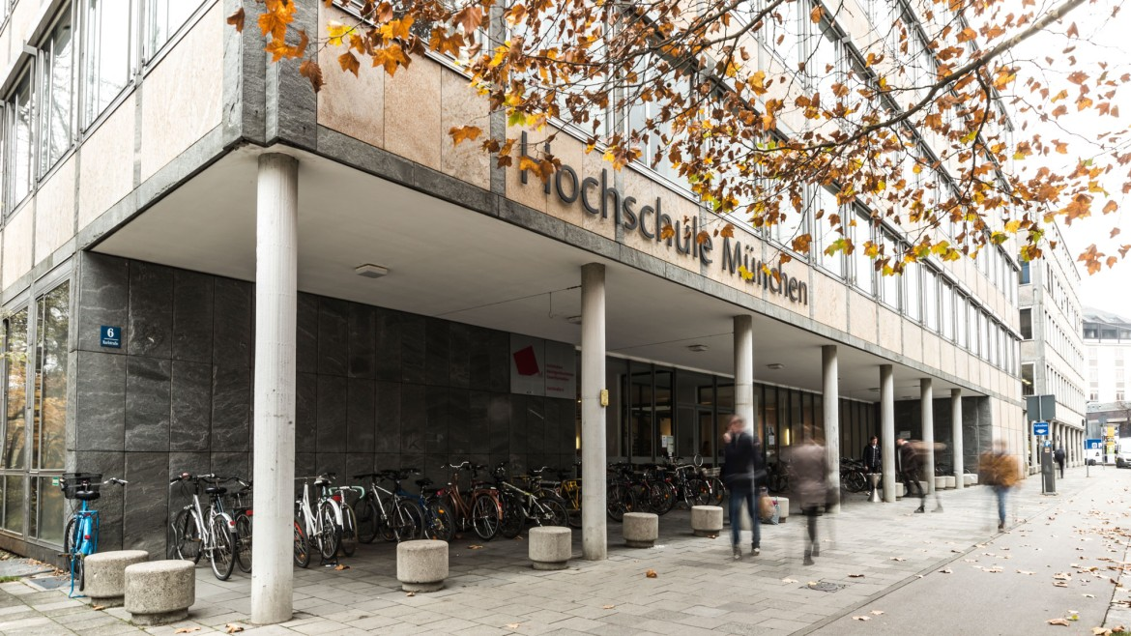
F 008?
Where is that?

Slide 3

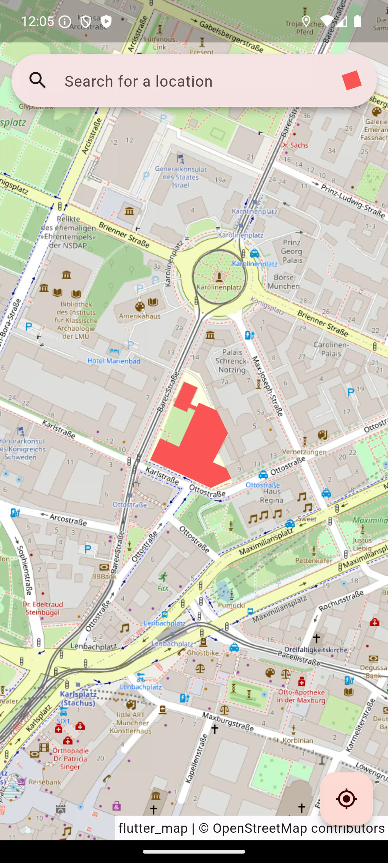
HM - Roomfinder
Made by
Michael Albrecht &&
Paul Köhler

Slide 4




